Slide 2
Background
The Sacramento Bee and Washington Post exposed how one large nursing home chain - Brius Healthcare - used financial schemes to get rich off taxpayers and elderly residents.

Slide 3
What’s NEW
Analyzing publicly available data, SEIU researchers found these elaborate schemes are widespread and growing among nursing home chains
The vast majority of California nursing homes now utilize “related party payments” and move more than $1 billion annually to related companies

Slide 4
Corporate Shell Games
HOW IT WORKS
Nursing home corporations set up “related companies” and pay themselves exorbitant management and administrative fees, moving money from resident care into the pockets of executives
EXAMPLE
Plum-owned nursing homes paid $37 million in “administrative” and “support services” fees to Plum Healthcare Group, LLC

Slide 5
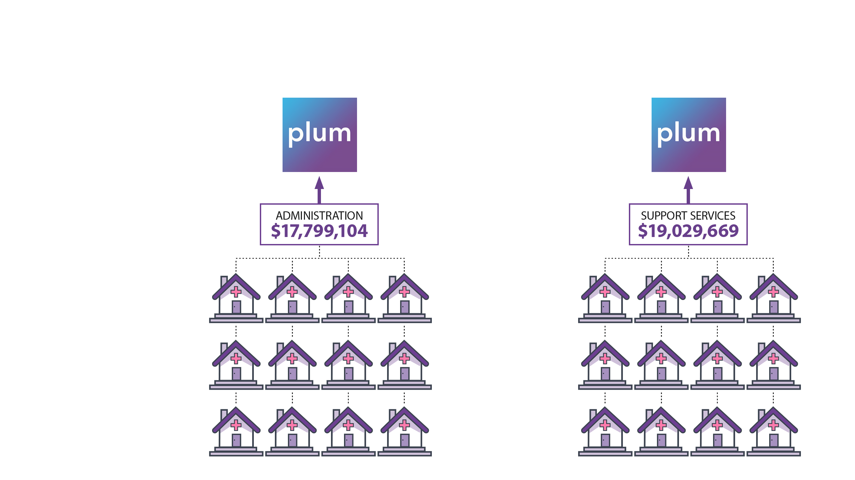
Example: Plum Healthcare Group
All Plum SNFs have an administrative services agreement with Plum Healthcare Group, LLC
Total administrative & support services $36,828,773

Slide 6
Example: 14 Layers of Corporate Ownership Structure
Cypress Ridge Care Center, a Plum Facility

Slide 7
Real Estate Shell Games
HOW IT WORKS
Nursing homes “rent” their space from their parent corporations or companies controlled by them.
Paying themselves rent is another way to move money from serving residents into the pockets of executives.
EXAMPLE
Companies controlled by Naveed Hakim, the CFO of Plum Healthcare, have collected more than $51 million in leases and rent from Plum nursing homes.

Slide 8
Example: Plum Healthcare
LEASES AND RENTALS
Companies controlled by Plum Healthcare CFO Naveed Hakim collected $51,202,466 in leases and rentals from Plum nursing homes

Slide 9
Family Shell Games
HOW IT WORKS
Nursing homes pay executives and their family members for services like “property management”
Paying themselves fees is another way nursing homes shift dollars from resident care into executives’ pockets
EXAMPLE
Prema and Anthony Thekkek have collected millions in “property management” and “management services” from Thekkek nursing homes

Slide 10
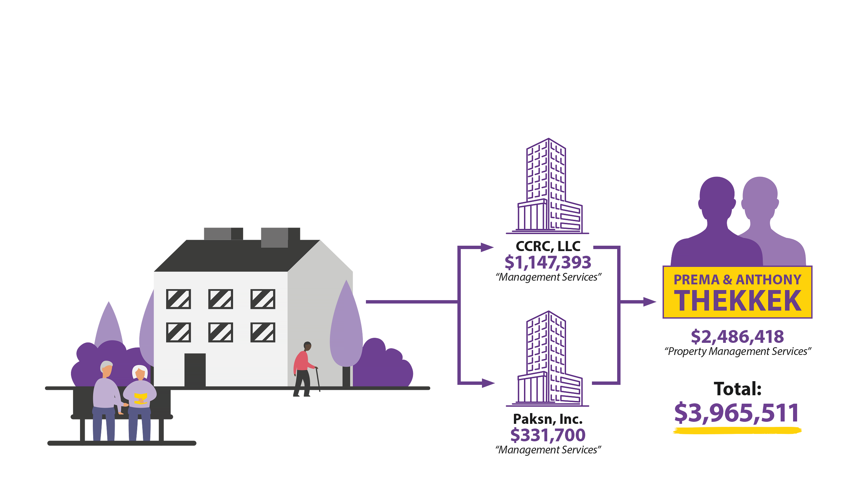
Example: Thekkek’s Creekside Rehabilitation & Behavioral Health
Santa Rosa, CA
Net Operating Revenue: $22,560,498
Expenses paid to related parties: $3.9 million (18%)
Reported net income: -$2.3 million

Slide 11
Schemes that skim dollars from taxpayers and elderly residents are widespread and growing.

Slide 12
Why it matters: Executives Get Rich; Collect Taxpayer Bailouts.
“The lack of transparency in California and across the country comes as the industry continues to vie for additional government funding, saying the cost of patient care during the coronavirus crisis has soared.”
- Washington Post 12/31/2020

Slide 13
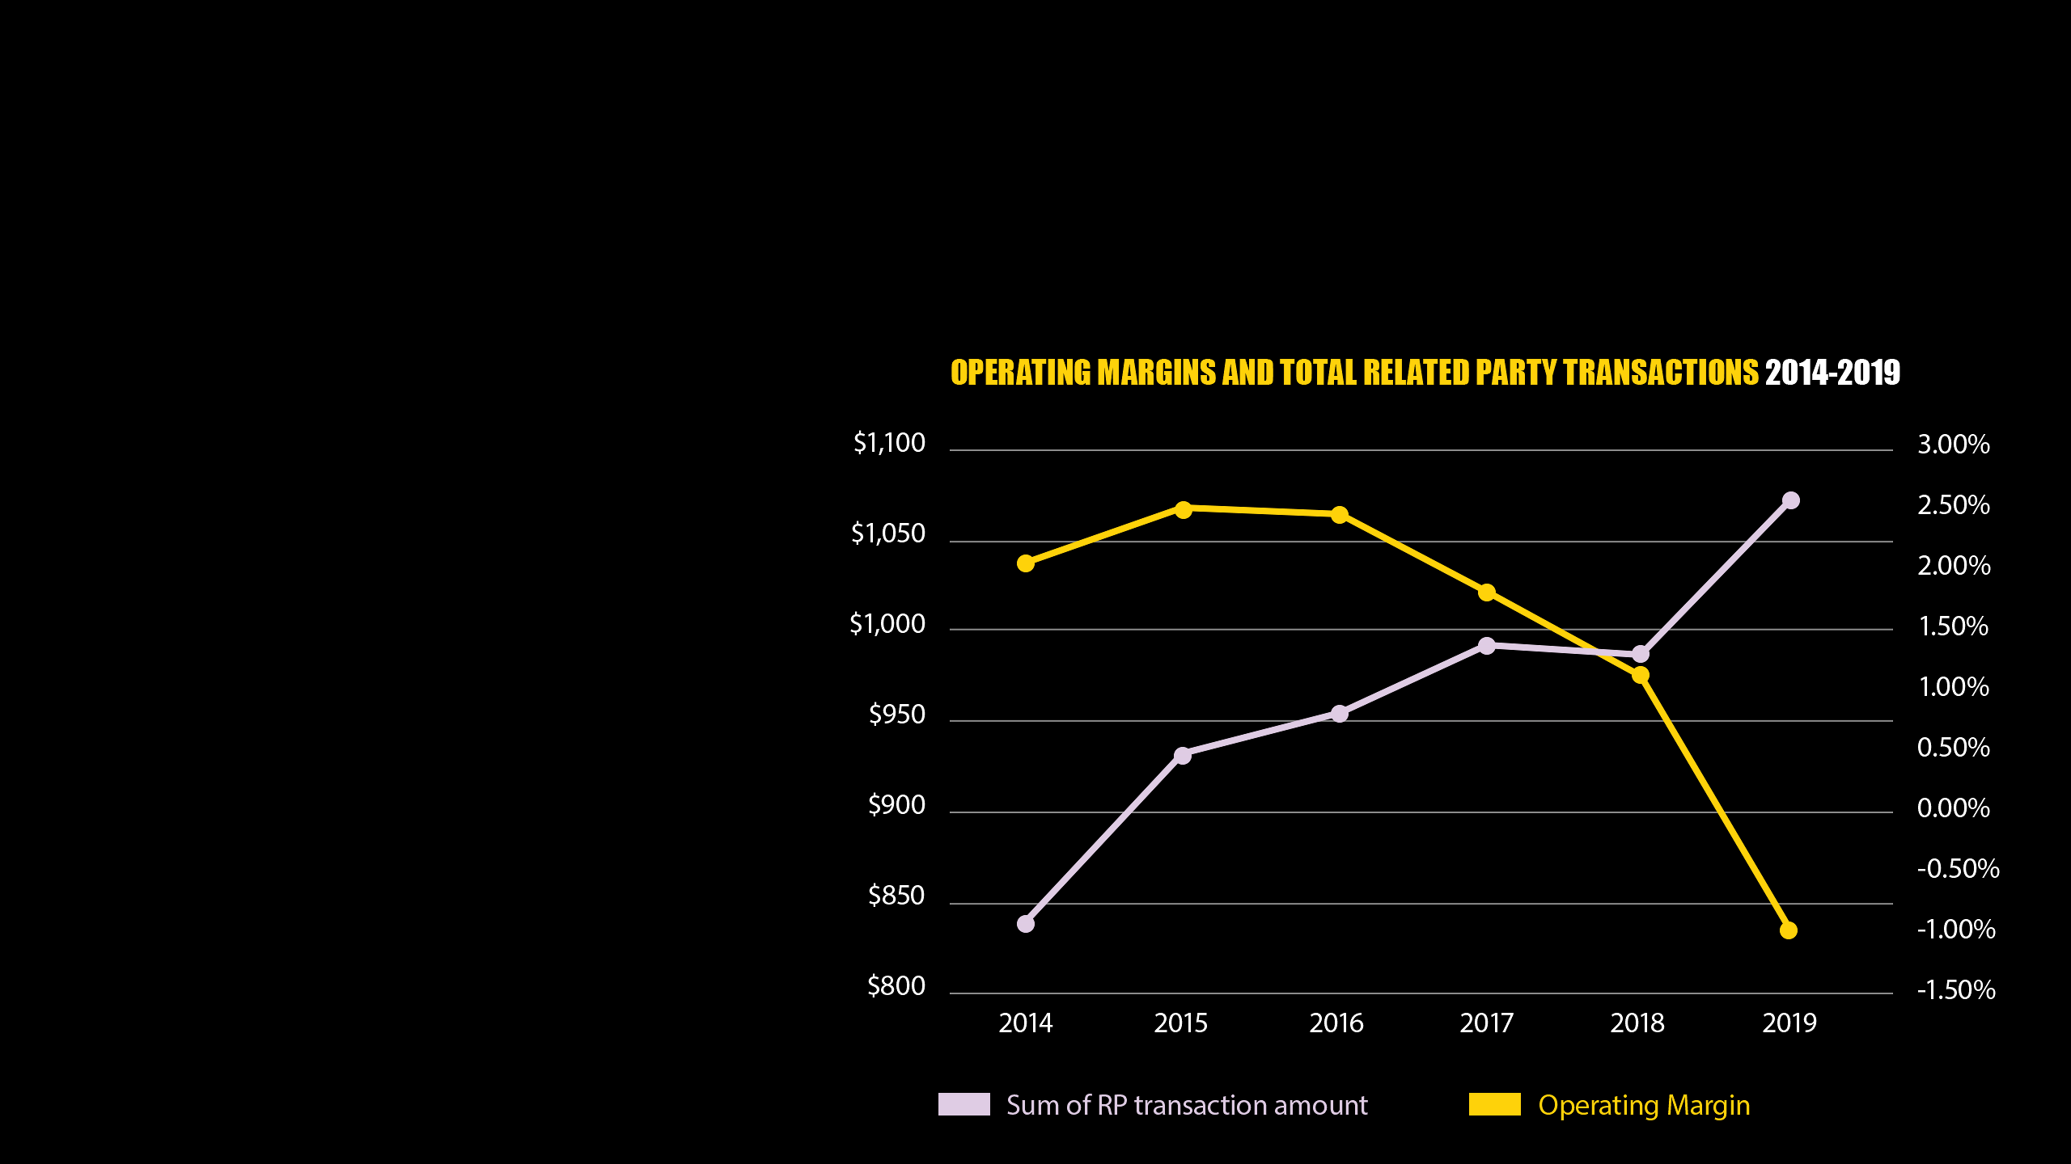
Why it matters: Executives Line their Pockets While Claiming Poverty
Federal and state governments have directed billions of dollars into a nursing home industry that claims to be struggling.
While nursing homes report diminished operating margins, the money they move into related companies has soared.

Slide 14
Why it matters: Nursing Home Workers Struggle with Understaffing
“A June 2021 survey from the American Health Care Association and National Center for Assisted Living (AHCA/NCAL) found 94% of nursing home providers had a shortage of staff members in the last month -- and more than half lost key members of their staff during the pandemic.”
- CNN 6/27/21

Slide 15
Why it matters: Dollars Diverted from Patient Care
A “2018 State Auditor’s report... found that nursing home residents are increasingly endangered despite our ballooning Medi-Cal payments intended to guarantee high quality care. Between 2006 and 2015, nursing home deficiencies that caused, or were likely to cause, serious injury or death to residents increased by 35 percent. During this period, annual Medi-Cal payments to nursing homes increased by 31 percent.”
- CANHR

Slide 16
Conclusion
SEIU researchers have documented the transfer of tens of millions of dollars from nursing homes to related companies, shell corporations, executives and their family members
These dollars come out of patient care, the vast majority paid by taxpayers.

Slide 17
What’s Next?
Publicly reported data just scratches the surface of related party payments. Taxpayers should demand audits to determine which are legitimate expenses and which are elaborate fraud schemes.
SB 650 (Stern) requires nursing homes to report certified financial statements.

